Slide 1
Device Security Scenarios Part 2: Enterprise Level Device Protection
Dec 2018
M3
Microsoft 365 Device Series

Slide 2
Agenda
Bios to UEFI Conversion
Credential Guard
Device Guard

Slide 3
BIOS to UEFI Conversion

Slide 4
Moving from BIOS to UEFI
Challenges
Many UEFI-Capable devices are running Windows in BIOS emulation mode today
Running older versions of Windows due to application compatibility reasons
Using CSM or Compatibility Support Module to allow booting in legacy BIOS mode to support some Option ROMs (e.g. Video BIOS, PXE) that don’t support UEFI
Moving existing PCs from BIOS emulation to native UEFI is challenging:
Use OEM tools to reconfigure firmware
Move data off, repartition disk
Apply Windows 10 image
Move data back
Windows 10 security features require UEFI Firmware
E.g. Secure Boot, Device Guard, Credential Guard
Upgrading devices from Windows 7/8.1 in BIOS mode to Windows 10 is not enough
Notes:
[Positioning]
We’ve heard from our customers that they want to take advantage of new Windows 10 security investments like Device Guard on their existing modern hardware, but many of these new features require UEFI-enabled devices. For those customers who have already provisioned modern Windows PCs that support UEFI but installed Windows 7 using legacy BIOS, converting a device to UEFI required an IT manager to repartition the disc and reconfigure the firmware. This meant they would need to physically touch each device in their enterprise. With the Creators Update, we introduced a simple conversion tool that automates this previously manual work. This conversion tool can be integrated with management tools such as System Center Configuration Manager (ConfigMgr)* as part of the Windows 7 to Windows 10 in-place upgrade process.”
UEFI compatibility introduced in Windows 7 (x64)
Windows 7 x64 has limited support for UEFI video, needs legacy video support to boot to point where a Windows video driver can take over.
Support on Class 2 systems running in legacy BIOS-compatibility mode by using a CSM, so they can use the legacy BIOS INT10 features.
Not supported on Class 3 systems, assumes the presence of legacy BIOS INT10 support not available in a Class-3 UEFI implementation.
A Majority of Windows 7 is deployed using Legacy BIOS
Windows 10 – Virtualization based security
Requires “Native” UEFI Deployment
GPT Partitioned Disks
Firmware Configuration (BIOS -> UEFI)
User Data MUST be moved off of the machine
Integration of Vendor Tools to manipulate firmware
Some instances require Firmware Upgrades

Slide 5

Firmware Comparison
BIOS
(Basic Input/Output System)
UEFI
(Unified Extensible Firmware Interface)
Capabilities
Released
1970’s
EFI (Intel) – July 2005
UEFI – Jan 2007
Boot Disks Size
Up to 2TB
2TB and above
Processor Compatibility
16-bit instruction set with
1MB addressable memory
Itanium, x86, x86-64, ARM, ARM64
Windows disk device compatibility
(Partition Style)
Master Boot Record
GUID Partition Table
Number of Partitions Supported
Up to 4 Primary Partitions
128 Partitions
(Windows Limit)
Max Partition Size
Up to 2TB
18 Exabytes
(Windows Limit – 256 TB)
Max Partition Size
Up to 2TB
18 Exabytes
(Windows Limit – 256 TB)
Boot Capabilities
Boot Sector
Boot Manager
(NVRAM stored)
Secure Boot Protocol Support (signed drivers)
N/A
Yes
Notes:
[Positioning]
Discuss the Firmware comparison between the BIOS and UEFI as shown in the slides

Slide 6
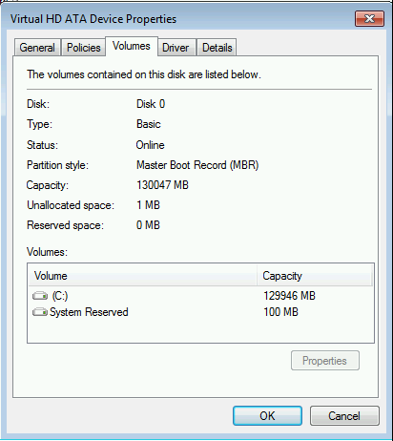
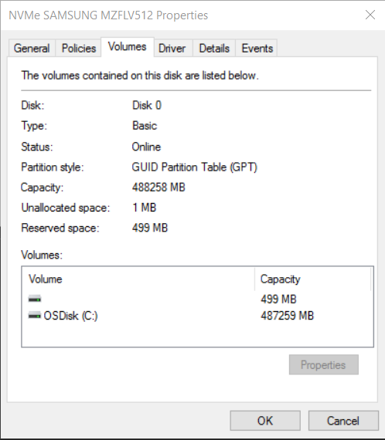
What is the Partition Style of a Hard Drive?
Master Boot Record
GUID Partition Table
Notes:
[Hidden Slide] – Show if needed

Slide 7
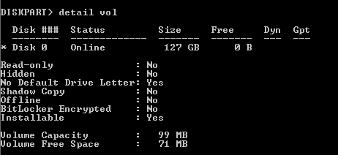
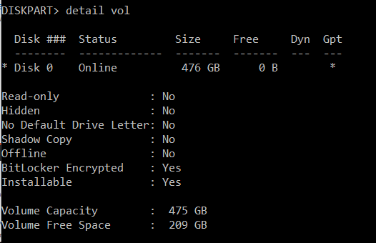
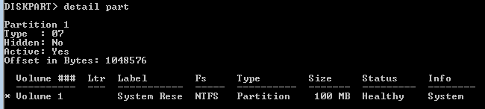
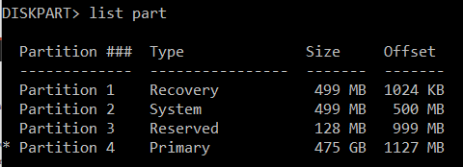
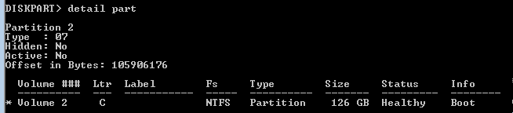
What is the Partition Style of a Hard Drive?
Master Boot Record
(Windows 7)
GUID Partition Table
Windows 10
Notes:
[Hidden Slide] – Show if needed

Slide 8
MBR2GPT Tool
Usage
You can use MBR2GPT to perform the following:
Within the Windows PE environment (Offline):
Convert any attached MBR-formatted disk to GPT, including the system disk. (Recommended)
From within the currently running OS (Online):
Convert any attached MBR-formatted disk to GPT, including the system disk.
Can be run in validation-only mode
Requirements
The MBR2GPT tool requires Windows 10 Creators Update
Can convert earlier version of Windows 10 (e.g. 1507, 1511, 1607) but must use WinPE Boot Image of 1703 in Offline mode
Earlier version of Windows (e.g. 7, 8, 8.1) must upgrade first to Windows 10 to boot from GPT
BitLocker Consideration
Protection must be suspended on all BitLocker-encrypted volumes of the disk
Recreate protectors to re-enable protection
Notes:
[Positioning]
Challenges:
MBR2GPT.EXE converts a disk from Master Boot Record (MBR) to GUID Partition Table (GPT) partition style without modifying or deleting data on the disk. The tool is designed to be run from a Windows Pre-installation Environment (Windows PE) command prompt but can also be run from the full Windows 10 operating system (OS).
Requires a wipe and reinstall to enable UEFI today
Windows requires GUID Partition Table (GPT) disk partitioning when booting in UEFI mode, whereas Master Boot Record (MBR) disk partition is required when booting in BIOS mode
No Microsoft-supported solution to perform non-destructive conversion from MBR to GPT
Support in-place conversion of disks from MBR partitioning to GPT partition
Does not modify or remove data that are already on the disk
Simplifies deployment by removing the need to backup/migrate data to an external location
Configures system partition for UEFI boot
Preserve drive letter assignment
Does not support configuring firmware mode
Switching firmware to UEFI mode typically requires manual configuration in firmware menu
Some OEMs provide tools to switch firmware mode programmatically
Usage:
The MBR2GPT tool can convert operating system disks that have earlier versions of Windows 10 installed, such as versions 1507, 1511, and 1607. However, you must run the tool while booted into Windows 10 version 1703 or later, and perform an offline conversion.
Offline conversion of system disks with earlier versions of Windows installed, such as Windows 7, 8, or 8.1 are not officially supported. The recommended method to convert these disks is to upgrade the operating system to Windows 10 first, then perform the MBR to GPT conversion.
FAQ:
Can be used offline or online
The tool is included in both of the Windows Pre-installation Environment (PE) as well the full windows environment
Running the tool from Windows PE s recommended to avoid potential interference from other software
Requires Windows 10 Creators Update
The tool must run in an environment based on the creators update version of Windows 10, but can convert disks with previous version of windows 10 (e.g. 1607) installed
Available on Insider Preview builds 15007 and higher
Can be run in validation-only mode
Verifies that the selected disk can be converted without actually performing the conversion
BitLocker Consideration
Protection must be suspended on all BitLocker-encrypted volumes of the disk
MBR2GPT will block conversion if any volume on the disk is encrypted using Bitlocker and protection is enabled
Full decryption of the encrypted volumes not required
Recreate protectors to re-enable protection
Remove all existing protectors (e.g. TPM, TPM+Pin) before performing conversion
Recreate protectors once device has booted into Windows 10 in UEFI mode

Slide 9
Options
Parameters
/validate
Perform only the disk validation steps and report whether the disk is eligible for conversion
/convert
Perform the disk validation and to proceed with the conversion if all validation tests pass
/disk
Specifies the disk number of the disk to be converted. By default the system disk is selected
/map
Specifies custom mappings between MBR and GPT partition types. Required if one or more of the existing MBR partitions are of types not recognized by Windows
/log
Specifies the location where logs should be written. By default, logs are written to the Windows Folder of the currently running environment
/allowFullOS
If running MBR2GPT from the full windows environment, this switch must be specified
Notes:
Validate – Testing via Scripting
[Positioning]
/disk
Specifies the disk number of the disk to be converted to GPT. If not specified, the system disk is used. The mechanism used is the same as that used by the diskpart.exe tool SELECT DISK SYSTEM command.
/map
Specifies additional partition type mappings between MBR and GPT. The MBR partition number is specified in decimal notation, not hexadecimal. The GPT GUID can contain brackets, for example: /map:42={af9b60a0-1431-4f62-bc68-3311714a69ad}. Multiple /map options can be specified if multiple mappings are required.
/log
Specifies the directory where MBR2GPT.exe logs should be written. If not specified, %windir% is used. If specified, the directory must already exist, it will not be automatically created or overwritten.
/allowFullOS
By default, MBR2GPT.exe is blocked unless it is run from Windows PE. This option overrides this block and enables disk conversion while running in the full Windows environment.
/validate
Perform only the disk validation steps and report whether the disk is eligible for conversion
/convert
Perform the disk validation and to proceed with the conversion if all validation tests pass

Slide 10
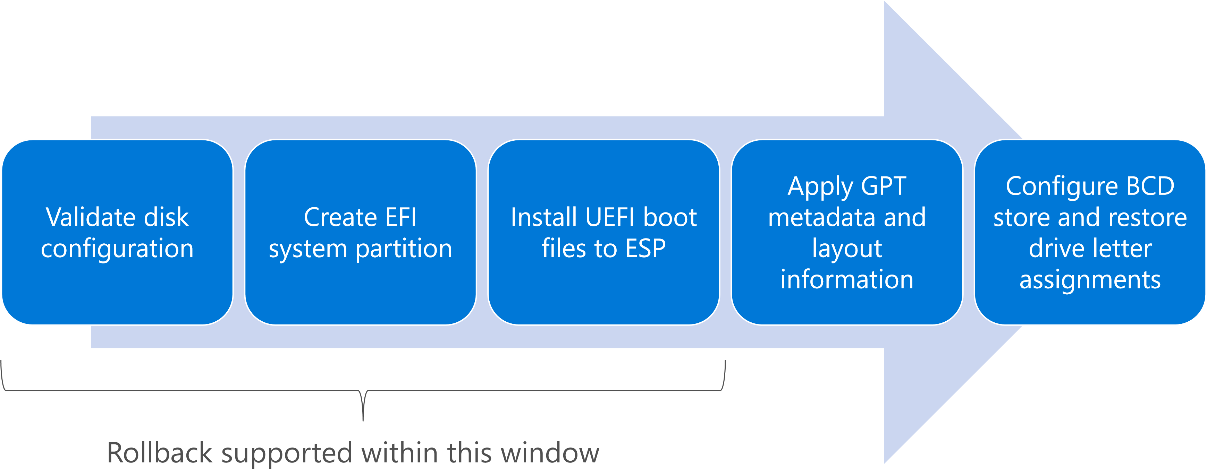
HOW MBR2GPT WORKS
Notes:
TRAINER NOTE - Now would be an excellent time to share that MBR2GPT once completed cannot be reversed. Make good backups.
[Positioning]
The benefits of this MBR to GPT conversion utility is that it makes it easier to convert systems from BIOS to UEFI and be able to take advantage of all the security features that comes in Windows 10 like Secure Boot, Device Guard and Credential Guard (to name a few). Currently, in order to stay supported by Microsoft, the hard disk needs to be completely repartitioned and formatted when switching from MBR to GPT. This is a destructive process and requires the user data to be backed up off of the hard drive, applications to be re-installed and then the user data restored once the new OS is up and running. Without the proper tools this can be a cumbersome task.

Slide 11
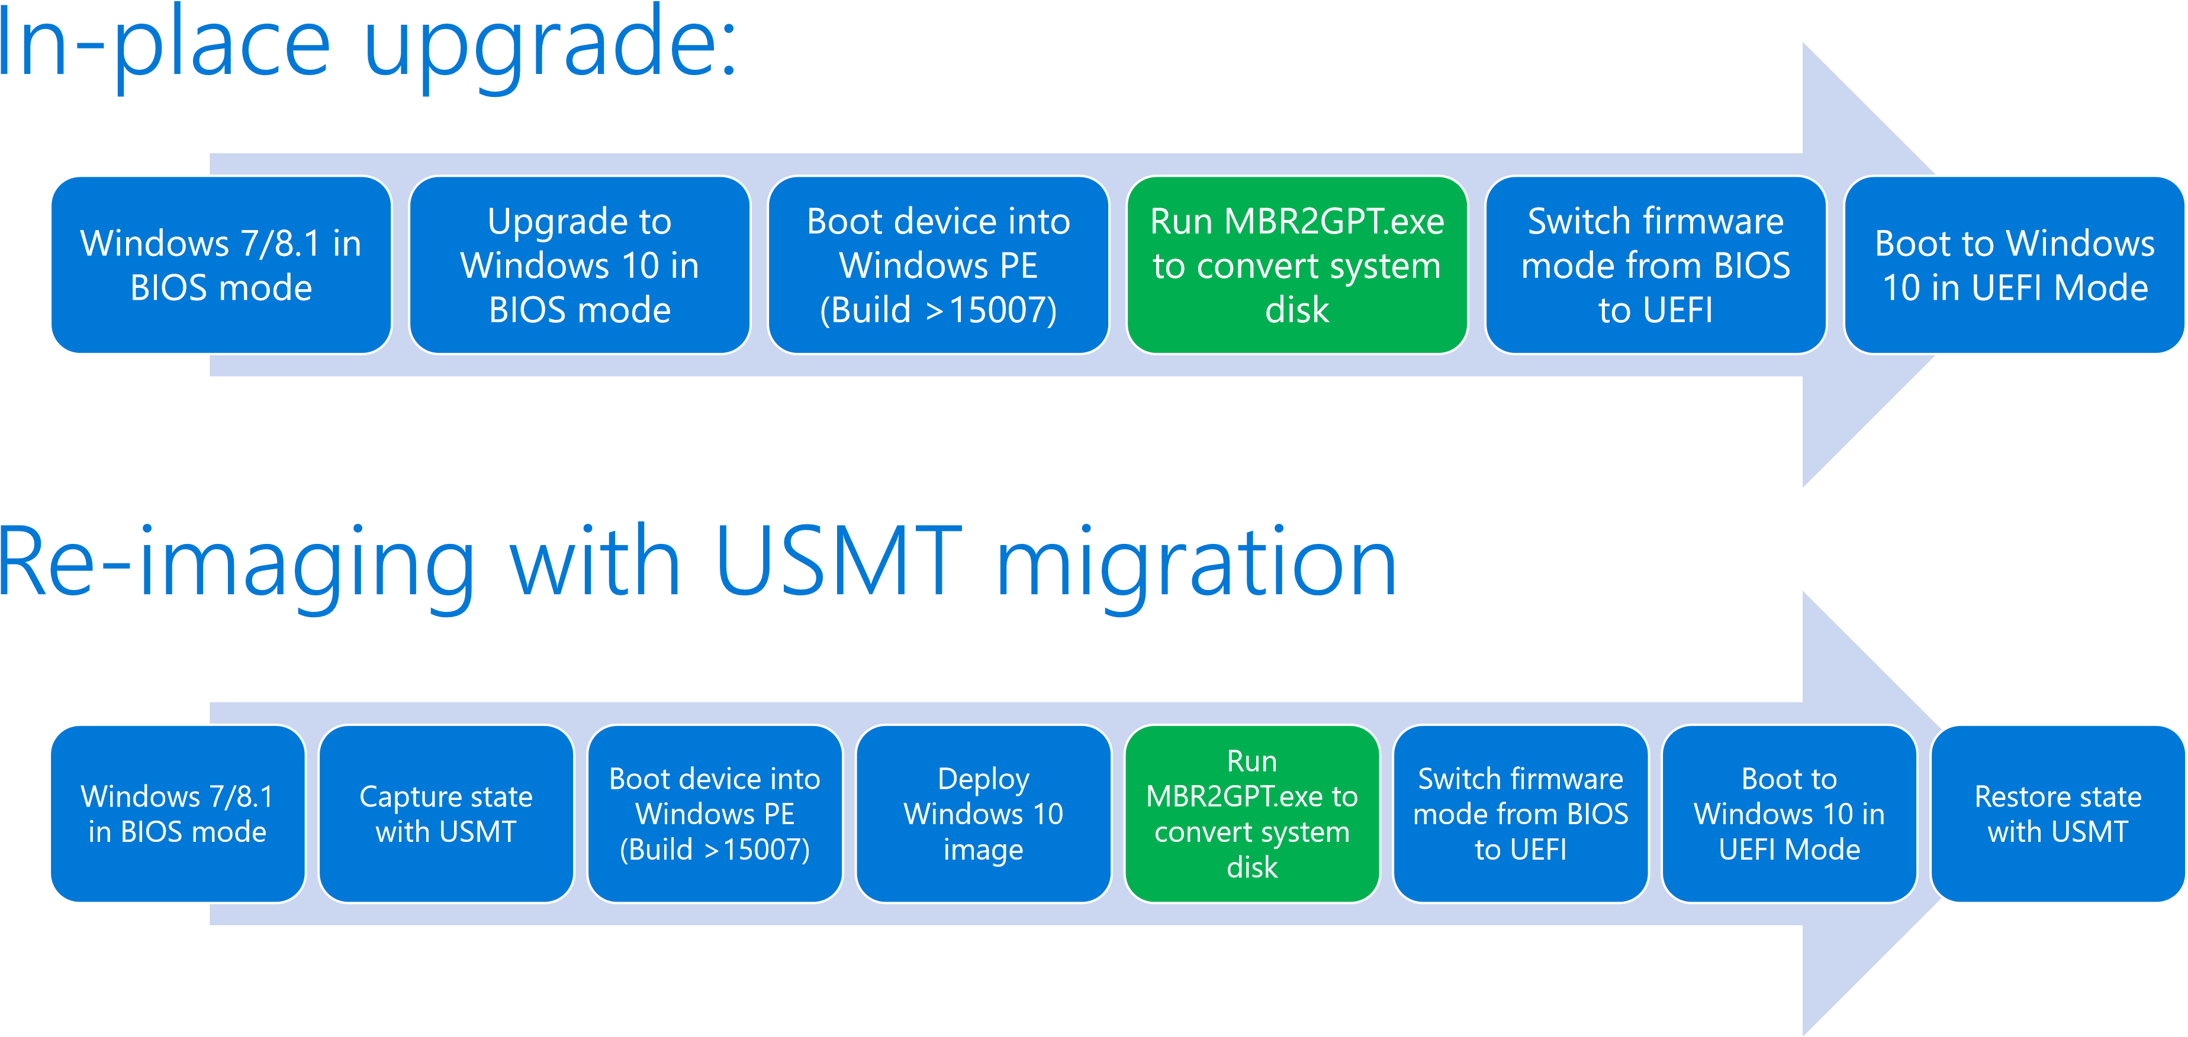
MBR2GPT Upgrade and Deployment Flow
Notes:
[Positioning]
Either doing a in-place upgrade or a re-imaging, Windows 10 OS must be on the device already before running the mbr2gpt.exe tool

Slide 12
Convert from BIOS to UEFI in an operating system upgrade task sequence
Overview
Windows 10 Creators Update introduces a simple conversion tool that automates the process to repartition the hard disk for UEFI-enabled hardware and integrates the conversion tool into the Windows 10 in-place upgrade process.
When you combine this tool with your operating system upgrade task sequence and the OEM tool that converts the firmware from BIOS to UEFI, you can convert your computers from BIOS to UEFI during an in-place upgrade to the Windows 10 Creators Update
Requirements
Windows 10 Creators Update
Computers that support UEFI
OEM tool that converts the computer’s firmware from BIOS to UEFI
Notes:
[Positioning]
Reference:
https://www.youtube.com/watch?v=hfJep4hmg9o
https://blogs.technet.microsoft.com/mniehaus/2017/04/14/moving-from-bios-to-uefi-with-mdt-8443/

Slide 13
How to convert from BIOS to UEFI in an operating system upgrade task sequence
Steps
1. Create an operating system upgrade task sequence that performs an in-place upgrade to Windows 10 Creators Update.
2. Edit the task sequence. In the Post-Processing group, add the following task sequence steps:
From General, add a Run Command Line step. You will add the command line for the MBR2GPT tool that coverts a disk from MBR to GPT without modifying or deleting data from the disk. In Command line, type the following: MBR2GPT /convert /disk:0 /AllowFullOS.
Add a step to start the OEM tool that will convert the firmware from BIOS to UEFI. This will typically be a Run Command Line task sequence step with a command line to start the OEM tool.
From General, add the Restart Computer step. For Specify what to run after restart, select The currently installed default operating system.
3. Deploy the task sequence.
Notes:
[Positioning]
Step 1 For details, see Create a task sequence to upgrade an operating system
Reference: https://docs.microsoft.com/en-us/sccm/osd/deploy-use/create-a-task-sequence-to-upgrade-an-operating-system
Step 2:
Note
You can also choose to run the MBR2GPT.EXE tool when in Windows PE instead of in the full operating system. You can do this by adding a step to restart the computer to WinPE before the step to run the MBR2GPT.EXE tool and removing the /AllowFullOS option from the command line. For details about the tool and available options, see MBR2GPT.EXE. https://technet.microsoft.com/itpro/windows/deploy/mbr-to-gpt

Slide 14
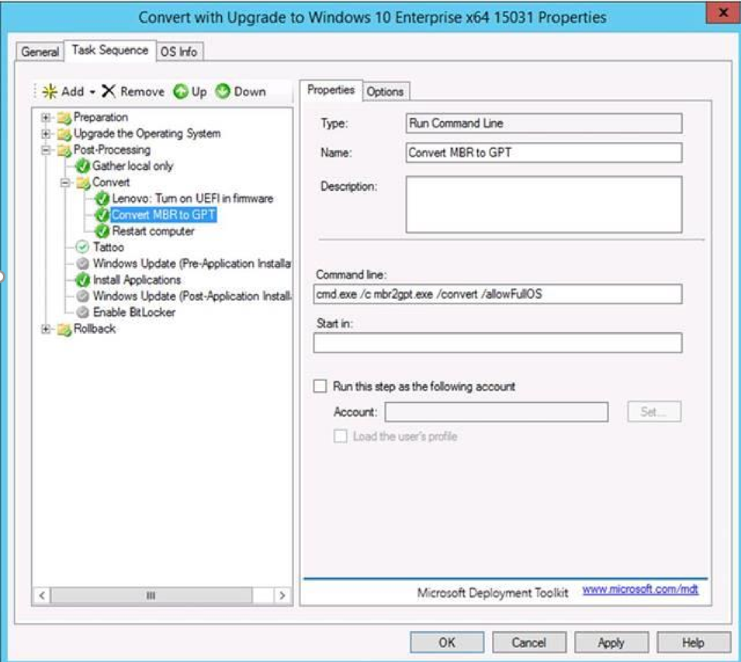
Automating BIOS-UEFI Conversion
Notes:
[Hidden Slide]
MBR2GPT is scriptable and can be used in SCCM/MDT task sequence
Unique return codes for troubleshooting in case of conversion failures
Use Windows PE from Creators Update version of the Assessment and Deployment Kit (ADK) if converting disks with previous versions of Windows 10
Reference: https://technet.microsoft.com/en-us/itpro/windows/deploy/mbr-to-gpt

Slide 15
Windows Defender Credential Guard

Slide 16
Windows Defender Credential Guard
Goal
Protects secrets from bad guys.
Align with goal to make credentials theft resistant and breach and phish proof.
Why keep secrets?
Single Sign-on (SSO)
Users enter credentials once
Signing on provides credentials to Windows
Authentication protocols (Security support providers (SSPs)) receive a copy of the credentials
SSPs cache the credential or derived credentials
Applications authenticate transparently
Authenticated connections to resources using SSP
Since SSPs have credentials, user connects without prompting
What are credentials?
Usernames & passwords
Certificates or public/private key pairs (Smart cards, Windows Hello, TLS certificates)
Derived keys (NT one-way function (NTOWF), Kerberos DES, RC4, AES long-lived keys)
Session keys (Kerberos TGT session keys, Kerberos Service ticket session keys)
Bearer tokens
Notes:
[Positioning]
The goal of Credential Guard is to protect secrets from bad guys. It isolates these secrets so that only privileged system software can access them. This way, it prevents any unauthorized access to these secrets that can lead to credential theft attacks, such as Pass-the-Hash or Pass-The-Ticket.
Secrets are kept to be able to use SSO. This way, when user connects to devices, apps, he doesn’t get prompted for credentials. Attackers steal these secrets to get users’ credentials and gain access to other machines on the network.

Slide 17
Windows Defender Credential Guard
Overview
Credential Guard helps to mitigate threats by using Hyper-V powered secure execution environment to protect NTLM tokens.
Prevents pass-the-hash attacks and enterprise credential theft that happens by reading and dumping the content of LSASS memory.
You can place items under Credential Guard, but they cannot be removed.
Decouples NTLM hash from logon secret.
Fully randomizes and manages full length NTLM hash to prevent brute force attack.
Improvements
Credential Manager support.
TPM 1.2 and 2.0 provides protection for encryption keys that are stored in the firmware and are used by Credential Guard.
Configuration Options
Enabled without lock (if you want to turn off remotely by using Group Policy).
Enabled with UEFI lock (Administrator must be physically present at a machine and disable Credential Guard).
Notes:
[Positioning]
Threat
Admin-level privilege is obtained to disable system defenses and evade detection (e.g. Pass the Hash attack).
Mitigation
Credential Guard helps to mitigate threats by using Hyper-V powered secure execution environment to protect NTLM tokens:
Prevents pass-the-hash attacks and enterprise credential theft that happens by reading and dumping the content of LSASS memory.
You can place items under Credential Guard, but they cannot be removed.
Decouples NTLM hash from logon secret.
Fully randomizes and manages full length NTLM hash to prevent brute force attack.
Improvements
Credential Manager support: with Credential Manager, credentials are stored in a virtual container so that even if hackers compromise the system, they cannot access the hash. That way, they cannot penetrate computers on the network.
TPM 1.2 and 2.0 provides protection for encryption keys that are stored in the firmware and are used by Credential Guard.
Configuration Options
Enabled without lock (If you want to turn off remotely by Group policy).
Enabled with UEFI lock (Administrator must be physically present at a machine and disable Credential Guard).

Slide 18
Pass the hash attacks
3.
Repeat.
1.
Single IT Pro’s machine is compromised.
IT Pro manages kiosks/shared devices on network.
Attacker steals IT Pro’s access token.
2.
Using IT Pro’s access token attacker looks for kiosk/shared devices and mines them for tokens.
Access to one device can lead to access to many
Notes:
[Positioning]
A typical PtH attack starts with one end-point being compromised through either a vulnerability exploit, malware, or both, which has then given the attacker admin-level access. With this access the malware can steal the user’s derived credentials, then move them to other devices on the network and impersonate the user from there.
As the attacker moves laterally across the network and finds additional devices, they may be able to steal credentials of other users who have previously signed onto those devices. Over time, an attacker typically gains access to a large set of credentials, some of which have increased levels privilege on devices and the network. Eventually it’s likely that the domain admin accounts will be compromised, and then you know what happens next…

Slide 19
Windows Defender Credential Guard
Threat
Admin level privilege is obtained to disable system defenses and evade detection (e.g. Pass the Hash attack)
Mitigation
Credential Guard helps to mitigate threats by using Hyper-V powered secure execution environment to protect NTLM tokens
Prevents pass-the-hash attacks and enterprise credential theft that happens by reading and dumping the content of lsass memory
You can place items under Credential Guard, but they cannot be removed
Decouples NTLM hash from logon secret
Fully randomizes and manages full length NTLM hash to prevent brute force attack
Improvements
Credential Manager support
TPM 1.2 and 2.0 provides protection for encryption keys that are stored in the firmware and are used by Credential Guard.
Configuration Options
Enabled without lock
Enabled with UEFI lock
Notes:
Firmware Requirements –
To verify that the firmware is using UEFI version 2.3.1 or higher, supports Secure Boot and has a secure update process you can validate it against the System.Fundamentals.Firmware.CS.UEFISecureBoot.ConnectedStandy Windows Hardware Compatibility Program requirement.
The secure MOR bit helps to prevent certain memory attacks.
Hardware Requirements
You cannot run Credential Guard on a virtual machine.
The features that virtualization-based security uses in the Windows hypervisor can only run on a 64-bit PC.
TPM 1.2 or 2.0 provides protection for encryption keys that are stored in the firmware. If you don't have a TPM installed, Credential Guard will still be enabled, but the keys used to encrypt Credential Guard will not be protected by the TPM.
Enable Credential Guard without UEFI lock. You can enable Credential Guard by using the registry. This allows you to disable Credential Guard remotely. However, we recommend that Credential Guard is enabled with UEFI lock. You can configure this by using Group Policy.
If you choose the Secure Boot and DMA protection option in the Group Policy setting, an IOMMU is required. The Secure Boot Group Policy option enables Credential Guard on devices without an IOMMU.
Credential Manager support. Credentials that are stored with Credential Manager, including domain credentials, are protected with Credential Guard with the following considerations:
Credentials that are saved by the Remote Desktop Protocol cannot be used. Employees in your organization can manually store credentials in Credential Manager as generic credentials.
Applications that extract derived domain credentials using undocumented APIs from Credential Manager will no longer be able to use those saved derived credentials.
You cannot restore credentials using the Credential Manager control panel if the credentials were backed up from a PC that has Credential Guard turned on. If you need to back up your credentials, you must do this before you enable Credential Guard. Otherwise, you won't be able to restore those credentials.
References
https://technet.microsoft.com/en-us/itpro/windows/keep-secure/credential-guard
https://technet.microsoft.com/en-us/itpro/windows/whats-new/credential-guard

Slide 20
Deployment considerations
Requirements
Windows 10 Enterprise x64 Edition
UEFI 2.3.1 or higher firmware and Secure Boot
TPM 2.0 (Note: TPM 1.2 can be used but is not recommended.)
Virtualization capable hardware
Physical device
The firmware is updated for Secure MOR implementation.
Optionally, A VT-d or AMD-Vi IOMMU (Input/output memory management unit)
Impacts
Credential Guard does not allow:
Unconstrained Kerberos delegation
NTLMv1, MS-CHAPv2, Digest, CredSSP, Kerberos DES encryption
Saved password in remote desktop
Some hardware and drivers may not work—The investigation and the tests should be conducted.
Deployment
Credential Guard policies are ignored on incompatible hardware.
Notes:
[Positioning]
Requirements
Windows 10 Enterprise x64 Edition
UEFI 2.3.1 or higher firmware and Secure Boot
TPM 2.0 (Note: TPM 1.2 can be used but is not recommended)
Virtualization capable hardware
Physical device
The firmware is updated for Secure MOR implementation
Optionally, A VT-d or AMD-Vi IOMMU (Input/output memory management unit)
Impacts
Credential Guard does not allow:
Unconstrained Kerberos delegation
NTLMv1, MS-CHAPv2, Digest, CredSSP, Kerberos DES encryption
Saved password in remote desktop.
Some hardware and drivers may not work. The investigation and the tests should be conducted.
Deployment
Check IT environment. Typically start with new environment of standard users or Administrator workstation, for example
Credential Guard policies are ignored on incompatible hardware

Slide 21


Windows Defender Credential guard and virtualization based security
Credential Guard uses VBS to isolate Windows authentication from Windows operating system.
Protects LSA Service (LSASS) and derived credentials (Kerberos Ticket; NTLM Hash).
Fundamentally breaks delivered credential theft using MimiKatz.
Apps
Credential Guard
Trustlet #2
Trustlet #3
Windows Platform Services
Kernel
Kernel
System Container
Device Hardware
Hypervisor
Notes:
[Positioning]
Credential Guard uses VBS to isolate Windows authentication from Windows operating system.
Protects LSA Service (LSASS) and derived credentials (Kerberos Ticket; NTLM Hash).
Fundamentally breaks delivered credential theft using MimiKatz.

Slide 22
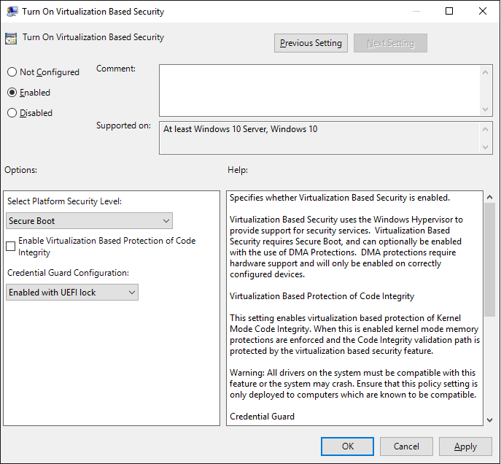
Windows Defender Credential Guard – How to Manage
GPO
Computer Configuration > Administrative Templates > System > Device Guard > Turn On Virtualization Based Security
Registry
Add the virtualization-based security features
Via Programs and Features ->
Select Hyper-V Hypervisor > Isolated User Mode
Via DISM
Enable Credential Guard
HKEY_LOCAL_MACHINE\System\CurrentControlSet\Control\DeviceGuard
EnableVirtualizationBasedSecurity (DWORD and set value 1 to enable virtualization-based security and set it to 0 to disable it)
RequirePlatformSecurityFeatures (DWORD and Set the value to 1 to use Secure Boot only or set it to 3 to use Secure Boot and DMA protection)
Notes:
Reference
https://technet.microsoft.com/en-ca/itpro/windows/keep-secure/credential-guard-manage

Slide 23
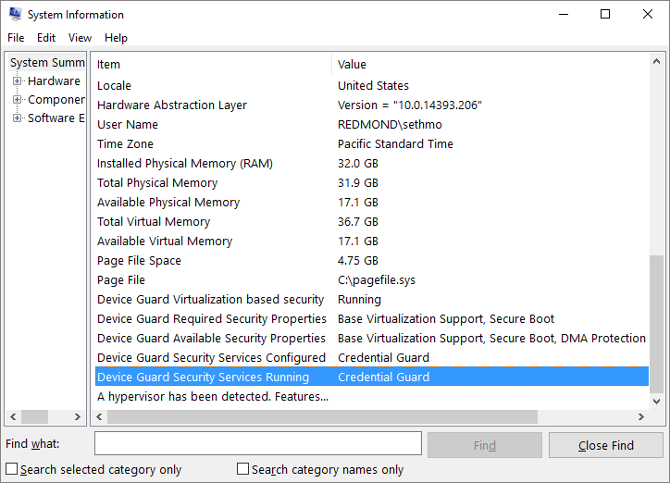
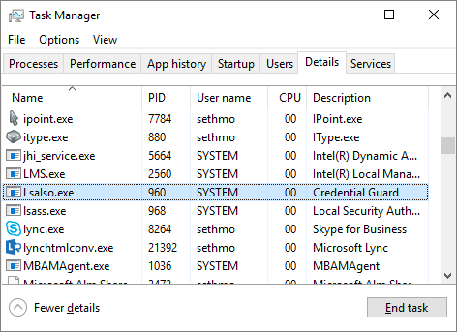
Verifying Credential Guard is running
System Information
Look to correct rows
LsaIso
Prior to 1703
If LsaIso.exe is running, Credential Guard is running
1703
LsaIso.exe may always run
Do not rely on LsaIso.exe as an indicator
Notes:
Positioning
New capability in Windows 10 1607
Improves remote desktop connection security
Background
Remote Desktop Connections are made by sending user credentials to the remote machine, after a successful network logon connection
Smart Card logins appear as connected locally to the remote machine
Credential derivatives are still left on the remote machine -> These derivatives can be used in attacks
Windows 8.1 introduced a new mode for Remote Desktop Connections
Connects using Network Logon only
Provides Limited Functionality for Administrators
No support for SSO
No support for multi-hop connections
User must be an admin on the remote machine
User is logged on as Local System
Outbound connections are made as local computer account, limiting access
Remote Credential Guard
Windows 10 1607 provides a better way
Connects using Network Logon, just like Restricted Admin Mode
Also sends credential derivatives (e.g., TGT) to the target, which are bound to a channel between the client and the target
The target must send these derivatives back to the client, if the target needs to use them. i.e., in order to acquire a Service Ticket
The target machine cannot use the credential derivatives (e.g., TGT) on its own, since it bound to the VC
Service Tickets are acquired on the target itself
STs only provide access to the resource they were issues for
Not a prime target
Are left on the target, as is, given that target has a user session running. Even when the remote desktop connection is severed.
References
Restricted Admin
https://technet.microsoft.com/en-us/library/dn408190.aspx
http://social.technet.microsoft.com/wiki/contents/articles/32905.how-to-enable-restricted-admin-mode-for-remote-desktop.aspx https://blogs.technet.microsoft.com/kfalde/2013/08/14/restricted-admin-mode-for-rdp-in-windows-8-1-2012-r2/

Slide 24
Remote Windows Defender Credential Guard
Overview
Requires Windows 10 1607
Security improvement over Remote Desktop Restricted Admin Mode
Supports SSO, multi-hop connection, non-admin scenarios
Outbound connections are made as the user
Features
Connects using Network Logon (same as Restricted Admin Mode in Windows 8.1)
Service Tickets acquired on the target – only provide access to the resource they are issued for (not prime security target)
Requirements
Client and Target device must be Windows 10 1607 or later
Devices must be able to authenticate using Kerberos
Considerations
Suitable for AD domain joined devices only
May impact scenarios where complex scripts are run on devices remotely when session disconnected
Notes:
Positioning
New capability in Windows 10 1607
Improves remote desktop connection security
Background
Remote Desktop Connections are made by sending user credentials to the remote machine, after a successful network logon connection
Smart Card logins appear as connected locally to the remote machine
Credential derivatives are still left on the remote machine -> These derivatives can be used in attacks
Windows 8.1 introduced a new mode for Remote Desktop Connections
Connects using Network Logon only
Provides Limited Functionality for Administrators
No support for SSO
No support for multi-hop connections
User must be an admin on the remote machine
User is logged on as Local System
Outbound connections are made as local computer account, limiting access
Remote Credential Guard
Windows 10 1607 provides a better way
Connects using Network Logon, just like Restricted Admin Mode
Also sends credential derivatives (e.g., TGT) to the target, which are bound to a channel between the client and the target
The target must send these derivatives back to the client, if the target needs to use them. i.e., in order to acquire a Service Ticket
The target machine cannot use the credential derivatives (e.g., TGT) on its own, since it bound to the VC
Service Tickets are acquired on the target itself
STs only provide access to the resource they were issues for
Not a prime target
Are left on the target, as is, given that target has a user session running. Even when the remote desktop connection is severed.
References
Restricted Admin
https://technet.microsoft.com/en-us/library/dn408190.aspx
http://social.technet.microsoft.com/wiki/contents/articles/32905.how-to-enable-restricted-admin-mode-for-remote-desktop.aspx https://blogs.technet.microsoft.com/kfalde/2013/08/14/restricted-admin-mode-for-rdp-in-windows-8-1-2012-r2/

Slide 25
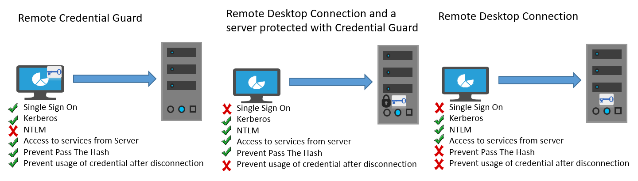
Remote Windows Defender Credential Guard
Overview
Remote Credential Guard helps to mitigate threats by blocking NTLM allowing only Kerberos, preventing Pass the Hash and previous usage of a credential after disconnection.
Notes:
[Positioning]
https://technet.microsoft.com/en-us/itpro/windows/keep-secure/remote-credential-guard
Introduced in Windows 10, version 1607, Remote Credential Guard helps you protect your credentials over a Remote Desktop connection by redirecting the Kerberos requests back to the device that's requesting the connection. It also provides single sign on experiences for Remote Desktop sessions. If the target device is compromised, your credentials are not exposed because both credential and credential derivatives are never sent to the target device.
You can use Remote Credential Guard in the following ways:
Administrator credentials are highly privileged and must be protected. By using Remote Credential Guard to connect, you can be assured that your credentials are not passed over the network to the target device.
Helpdesk employees in your organization must connect to domain-joined devices that could be compromised. With Remote Credential Guard, the helpdesk employee can use RDP to connect to the target device without compromising their credentials to malware.
Comparing Remote Credential Guard with a server protected with Credential Guard
Use the following diagrams to help understand how Remote Credential Guard works, what it helps protect against, and how it compares with using a server protected with Credential Guard. As the diagram shows, Remote Credential Guard blocks NTLM (allowing only Kerberos), prevents Pass the Hash, and prevents usage of a credential after disconnection.

Slide 26
Windows Defender Device Guard

Slide 27
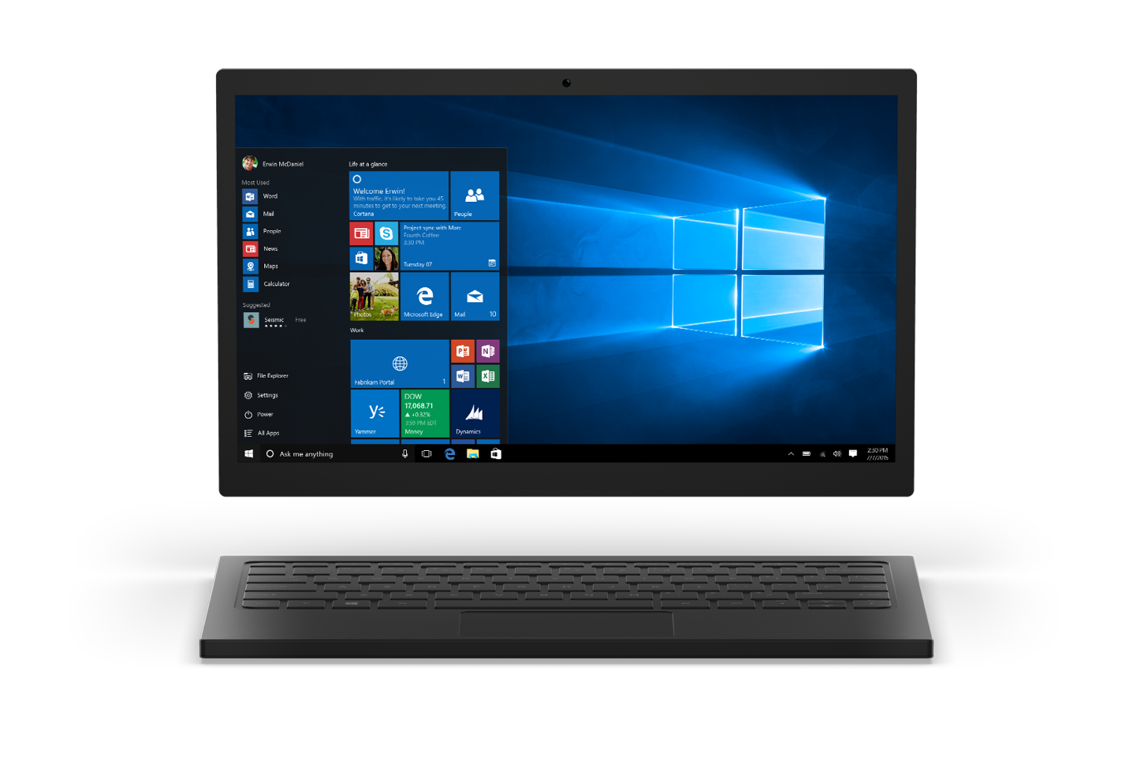
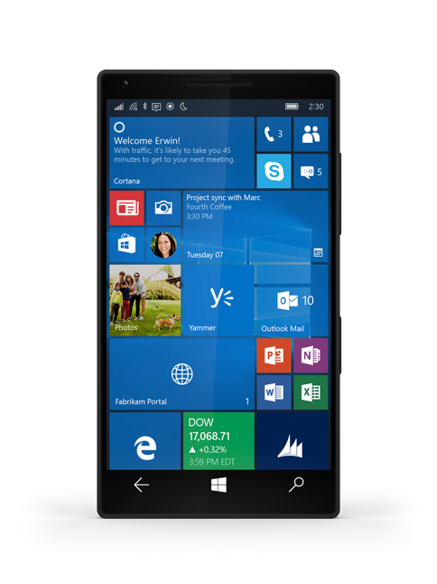
Windows Defender Device Guard Introduction
Challenge
Apps are trusted by default until they are defined as threat
Detection method alone can’t keep up
Security
Security depends on a platform where apps must earn trust before use
App Control
Next generation app control
Secure devices with Device Guard
Notes:
Positioning
Target at devices that meet the hardware and device driver signing requirements only
References
https://technet.microsoft.com/en-us/itpro/windows/whats-new/device-guard-overview?f=255&MSPPError=-2147217396
https://technet.microsoft.com/en-us/itpro/windows/keep-secure/device-guard-deployment-guide

Slide 28
Windows Defender Device Guard UMCI
Device Guard User Mode Core Integrity
What?
Device Guard User Mode Code Integrity (UMCI)
Protect against malicious software run by a user account with Administrator privileges
Protect against viruses and malware
How
User Mode Code Integrity
…
Requirements
Virtualization extensions and input/output memory management unit (IOMMU) support
Hardware with VT-X and VT-D
64-bit CPU
UEFI version 2.3.1
Drivers compatible with the feature, or the device may crash
Drivers signed for Windows 10 by the Microsoft WHQL (Windows Hardware Quality Labs) portal
Notes:
Positioning
Target at devices that meet the hardware and device driver signing requirements only
References
https://technet.microsoft.com/en-us/itpro/windows/whats-new/device-guard-overview?f=255&MSPPError=-2147217396
https://technet.microsoft.com/en-us/itpro/windows/keep-secure/device-guard-deployment-guide

Slide 29
Windows Defender Device Guard
Device Guard User Mode Core Integrity
Overview
Windows desktop can be locked down to only run trusted apps
Supports Win32 and Modern Applications
Enforced via Code Integrity Policy
Requirements
Windows 10 Enterprise, Windows 10 Education or Windows Server 2016
Apps must be signed in order to be used
Benefits
Untrusted apps and executables are unable to run
Resistant to tampering by an administrator or malware
Application Signing Options
Corporate digital certificate or public key infrastructure
Signing portal (web service in Windows Store for Business for classic Windows apps)
Non-Microsoft signing authority
Using the Windows Store publishing process
Code Integrity Policy
Restricts what code can run on a device
Binary-encoded XML document that includes configuration settings to be applied to the device via management tooling
Notes:
Overview
So what exactly is Device Guard?
Device configuration for of Windows that literally locks the device down such that it can only run trusted applications. If the app isn’t trusted it can’t run, period.
There are no platform or app vulnerability related bypasses that attackers can use and even if an attacker manages to gain control of the kernel they couldn’t run malicious executable code as the lockdown occurs at the hardware level and the decision making on what is allowed to run vs not is completely isolated from the operating system.
The decision making is performed in the Windows Code Integrity services which has been moved out of Windows and runs alongside it in a Hyper-V protected container that we call a Virtual Secure Mode. The service determines what is trustworthy vs not based on signatures that are baked into and protected by the hardware itself (UEFI firmware).
References
https://technet.microsoft.com/en-us/itpro/windows/whats-new/device-guard-overview
https://technet.microsoft.com/en-us/itpro/windows/manage/device-guard-signing-portal
https://technet.microsoft.com/itpro/windows/keep-secure/creating-a-device-guard-policy-for-signed-apps
https://technet.microsoft.com/itpro/windows/keep-secure/getting-apps-to-run-on-device-guard-protected-devices
https://technet.microsoft.com/en-us/itpro/windows/keep-secure/device-guard-certification-and-compliance

Slide 30
Windows Defender Device Guard Overview
User Mode Code Integrity vs Kernel Mode Code Integrity
Overview of KMCI
Enforces code integrity for kernel mode code
KMCI vs UCMI
Kernel Mode Code Integrity (KMCI) protects the kernel mode from running unsigned drivers.
User Model Code Integrity (UMCI) protects malware and virus. This feature is extended from KMCI.
Hypervisor Code Integrity (HVCI) offers vulnerability exploit protection capabilities by ensuring that all software running in kernel mode, including drivers, securely allocate memory and operate as they are intended.
Notes:
Overview
So what exactly is Device Guard?
Device configuration for of Windows that literally locks the device down such that it can only run trusted applications. If the app isn’t trusted it can’t run, period.
There are no platform or app vulnerability related bypasses that attackers can use and even if an attacker manages to gain control of the kernel they couldn’t run malicious executable code as the lockdown occurs at the hardware level and the decision making on what is allowed to run vs not is completely isolated from the operating system.
The decision making is performed in the Windows Code Integrity services which has been moved out of Windows and runs alongside it in a Hyper-V protected container that we call a Virtual Secure Mode. The service determines what is trustworthy vs not based on signatures that are baked into and protected by the hardware itself (UEFI firmware).
References
https://technet.microsoft.com/en-us/itpro/windows/whats-new/device-guard-overview
https://technet.microsoft.com/en-us/itpro/windows/manage/device-guard-signing-portal
https://technet.microsoft.com/itpro/windows/keep-secure/creating-a-device-guard-policy-for-signed-apps
https://technet.microsoft.com/itpro/windows/keep-secure/getting-apps-to-run-on-device-guard-protected-devices
https://technet.microsoft.com/en-us/itpro/windows/keep-secure/device-guard-certification-and-compliance

Slide 31
Windows Defender Device Guard
KMCI in Device Guard verifies the digital signature of code during Windows boot process
Platform Secure Boot
UEFI Secure Boot
KMCI
UMCI
AppLocker
ROM/Fuses
Bootloaders
Native UEFI
Windows
OS Loader
Windows Kernel, Boot Drivers, System Files
ELAM, AV Driver, and 3rd Party Drivers
User mode code (apps, etc.)
Notes:
[Positioning]
Make sure you understand the difference between Kernel Mode Code Integrity, User Mode Code Integrity and Hypervisor Code Integrity.
Boot integrity (or platform secure boot) from power-on provides the protections against physically present attackers.
https://msdn.microsoft.com/ja-jp/library/windows/hardware/mt767514(v=vs.85).aspx
Reference: Overview
https://technet.microsoft.com/en-us/itpro/windows/keep-secure/introduction-to-device-guard-virtualization-based-security-and-code-integrity-policies
Reference: Difference
https://blogs.technet.microsoft.com/ash/2016/03/02/windows-10-device-guard-and-credential-guard-demystified/
Kernel Mode Code Integrity (KMCI) protects the kernel mode from running unsigned drivers.
User Model Code Integrity (UMCI) protect malware and virus. This feature is extended from KMCI.
Hypervisor Code Integrity (HVCI) offers vulnerability exploit protection capabilities by ensuring that all software running in kernel mode, including drivers, securely allocate memory and operate as they are intended.

Slide 32
Windows Defender Device Guard Management
Group Policy
Windows 10 provides an administrative template to configure and deploy the configurable code integrity policies
Template allows to specify which hardware-based security features to enable and deploy
Manage catalog files
Microsoft System Center Configuration Manager
Simplify deployment and management of catalog files, code integrity policies, and hardware-based security features
Provide version control
Windows PowerShell
Create and service code integrity policies
Notes:
References
https://technet.microsoft.com/en-us/itpro/windows/keep-secure/introduction-to-device-guard-virtualization-based-security-and-code-integrity-policies#new-and-changed-functionality

Slide 33

Virtualization Based Security
Device Guard is tamper proof
Running in Virtualization based environment
Apps
DEVICE GUARD
Trustlet #2
Trustlet #3
Windows Platform Services
Kernel
Kernel
Windows Operating System
System Container
Hyper-V
Hyper-V
Device Hardware
Hypervisor
Notes:
Virtualisation Based Security:
Isolate components out of Windows and moving them into separate hardware isolated containers.
Anything running in that container should be safe.

Slide 34
Windows Defender Device Guard UMCI vs AppLocker
Comparison
AppLocker and Device Guard should run side-by-side
Device Guard does not intend to replace AppLocker, but to complement it.
Device Guard enforces code integrity, but there are scenarios that cannot be covered.
There are also situations where Device Guard cannot be fully implemented.
Best practice
Enforce code integrity policies at the most restrictive level possible
Use AppLocker to fine-tune the restrictions to an even lower level
Best practice
Enforce code integrity policies at the most restrictive level possible
Use AppLocker to fine-tune the restrictions to an even lower level
Notes:
References
https://technet.microsoft.com/en-us/itpro/windows/keep-secure/introduction-to-device-guard-virtualization-based-security-and-code-integrity-policies#new-and-changed-functionality

Slide 35
Labs
Lab 6 – BIOS to UEFI3 – Deploy Credential Guard
Lab 7 – Device & Credential Guard
https://m365.learnondemand.net
Notes:
Refer to lms.learnondemand.net for instructor access to labs
Labs Security
Introduction to Hands On Labs
Deploy Windows Hello for Business
Deploy Credential Guard
Prevent Ransomware with Device Guard
Configure Conditional Access with AAD, Intune and Office 365
Configure Azure Information Protection
Protect Apps with Microsoft Intune Mobile Application Management
Deploy Windows Information Protection
Consolidate Windows and Azure Information Protection
Configure Systems to Meet Governance Standards
Prepare for General Data Protection Regulation Compliance
Analyze and Mitigate Security Threats and Windows Defender ATP
Protect Office Documents with Microsoft Office 365 ATP
Protect Cloud Apps with Microsoft Cloud App Security
Protect Users and Devices with Microsoft Advanced Threat Analytics

Slide 36
Thank You

